Slide 1
Programming Fundamentals
Mr. Ali Haider
School of CS & IT
Institute of Management Sciences, Peshawar, Pakistan

Slide 2
What Is a Computer
"Takes input, processes it, gives output.”
An electronic device that accepts data, processes it per instructions, and produces output, using memory to store data/instructions.
Model: Input → Process → Output
Analogy: A kitchen - ingredients (input), chef following a recipe (process), meal (output).
What's the input/process/output of a calculator app?

Slide 3
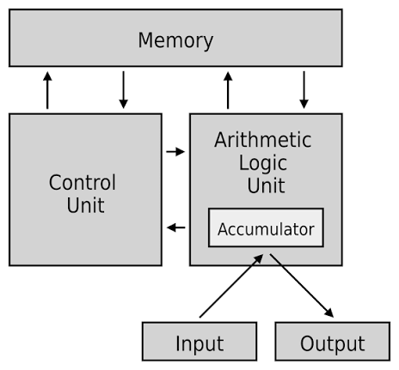
Basic Components of a Computer
CPU - Control Unit (directs operations) + ALU (calculations/comparisons)
RAM - Temporary memory while running
Storage - Permanent (HDD/SSD)
Input devices (keyboard, mouse)
Output devices (monitor, printer)
Why does a file survive a shutdown, but an unsaved calculation doesn't?

Slide 4
How a Computer Executes a Program
Levels: Machine code (binary) → Assembly (MOV, ADD) → High-level language (C++)
Formal: The CPU fetches, decodes, and executes binary instructions (fetch-decode-execute cycle).
Analogy: Speaking through a translator - you speak C++, the "translator" converts it to machine code.
Why don't we just write 0s and 1s directly?

Slide 5
What Is Programming?
Simple: "Giving a computer step-by-step instructions to solve a problem.”
Formal: The process of designing, writing, testing, and maintaining instructions (a program) a computer can execute.
Analogy: A recipe precise enough that a first-time cook gets it right every time.
Explain, step by step, how to tie a shoelace to someone who's never done it.

Slide 6
What Is a Programming Language?
Formal: A formal set of syntax/semantic rules for writing programs translatable into machine instructions.
Categories: Low-level (Assembly, machine code) vs. High-level (C++, Python, Java)
Why C++: teaches core logic - variables, control flow, functions, memory - that transfers to any language later.

Slide 7
Feature | Programming Language | Scripting Language | Markup Language
Primary Purpose | Creating full-scale, standalone applications and systems from scratch. | Automating tasks, connecting software, or adding interactivity. | Structuring, organizing, and formatting content/text.
How it Executes | Usually compiled into machine code before running. | Usually interpreted line-by-line during runtime. | Read and rendered directly by a browser or processor.
Logic & Math | Deep support for complex algorithms, data structures, and logic. | Supports programming logic, loops, and conditional statements. | No programming logic, math capabilities, or variables.
Environment | Runs independently as a standalone program. | Often runs inside a “host” environment or another program. | Needs a parser or browser to display the data.
Examples | C++, Java, Rust, Go. | JavaScript, Python, Bash, PHP. | HTML, XML, Markdown.

Slide 8
What is C++
https://www.geeksforgeeks.org/cpp/history-of-c/

Slide 9
What Is an IDE
Simple: "An IDE is a single program that gives you everything you need to write, compile, and run code - instead of using separate tools for each step."
An Integrated Development Environment (IDE) is a software application that combines a code editor, compiler/interpreter, and debugger into one unified interface, streamlining the process of writing, building, and testing programs.
Core components of an IDE:
Code Editor - where you type source code (with syntax highlighting, auto-indent, line numbers)
Compiler (integrated) - Dev C++ uses GNU G++ under the hood to translate your .cpp file into an executable
Debugger - lets you pause execution, inspect variable values, and step through code line by line
Build/Run controls - one-click Compile and Run buttons instead of typing terminal commands manually

Slide 10
Dev C++
Free, lightweight, and beginner-friendly - minimal setup overhead
Comes bundled with the GNU G++ compiler (no separate compiler installation needed)
Simple menu structure: Execute → Compile, Execute → Run
Clear, readable compiler error messages in a dedicated output pane - good for learning to debug

Slide 11
Dev C++
Real-world analogy: Think of an IDE like a fully equipped workshop - instead of walking to different rooms for a workbench (editor), tools (compiler), and a inspection table (debugger), everything is in one room, ready to use.
Without an IDE (the manual alternative, for awareness):
  Write code in any plain text editor (e.g., Notepad)
  Open a terminal/command prompt
  Compile manually: g++ filename.cpp -o filename
  Run manually: filename.exe (Windows) / ./filename (Linux/Mac)

Slide 12
Source Code, Compiler, Executable
Source code (.cpp, human-readable) → Compiler (G++) translates + checks errors → Executable (.exe) runs.
Flow: Source Code → Compile → Executable → Run → Output
Analogy: Writing a letter in English, translating it to French, then the French reader can act on it.

Slide 13
Compiler vs. Interpreter
Compiler - translates the whole program before running (C++/G++).
Interpreter - translates line-by-line while running (e.g., Python).
Key point: C++ must compile successfully before it can ever run.

Slide 14
Syntax vs. Semantics
Content: Syntax = grammar rules; Semantics = meaning.
int x = 5 // missing semicolon → syntax error
int x = "five" // wrong data type → semantic/logic issue
Analogy: "I eated the apple" (broken grammar) vs. "I ate the moon" (grammatically fine, meaningless).
Discussion question: "Which is harder to catch - a missing semicolon, or a program that runs but gives the wrong answer?"

Slide 15
Algorithms: Thinking Before Coding
Formal: A finite, ordered sequence of well-defined steps that solves a problem.
Example - largest of 3 numbers:
  Input three numbers
  Compare first two, keep the larger
  Compare that result with the third
  Display the largest
Analogy: Planning a road-trip route before driving.
Discussion question: "Write your own algorithm to find the smallest of 3 numbers."

Slide 16
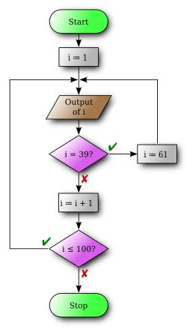
Flowcharts
Content:
  Oval = Start/End,
  Rectangle = Process,
  Diamond = Decision,
  Arrow = Flow
What do you think a diamond shape represents in a flowchart?

Slide 17
Pseudocode
START
INPUT a, b, c
IF a > b AND a > c
  THEN largest = a
ELSE IF b > c
  THEN largest = b
ELSE
largest = c
PRINT largest
END
Discussion question: "Convert your Slide 11 algorithm into pseudocode."

Slide 18
Your First C++ Program
#include <iostream>
using namespace std;
int main()
{
cout << "Hello, World!" << endl;
return 0;
}

Slide 19
Common Programming Errors (First Exposure)
Syntax error (breaks language rules, compiler catches it)
Runtime error (crashes while running, e.g., divide by zero)
Logical error (runs fine, wrong answer)
Discussion question: "Does compiling and running without crashing guarantee the program is correct?"

Slide 20
Why Learn Programming?
Content: Software development, automation, data analysis/AI, general problem-solving skill, high career demand.

Slide 21
Setting Up: Dev C++ / G++
Open Dev C++ → New source file → save as filename.cpp
Write code
Compile: Execute → Compile (or g++ filename.cpp -o filename)
Run: Execute → Run (or ./filename)
View output in console.

Slide 22
Any Questions?

Slide 23
Thank You

